Slide 1
NoSQL Databases and MongoDB
Welcome to the JSON-stores world
Telerik Software Academy
Learning & Development
http://academy.telerik.com

Slide 2
Table of Contents
Database Systems
Relational and No-relational Databases
NoSQL Databases
MongoDB
Installing MongoDB Drivers
Creating and Hosting MongoDB
Locally and in the cloud
MongoDB Viewers

Slide 3
Table of Contents (2)
MongoDB and Node.js
Opening connections to MongoDB from Node.js
CRUD operations with Node.js
Querying MongoDB Documents using Node.js

Slide 4
Database Systems

Slide 5
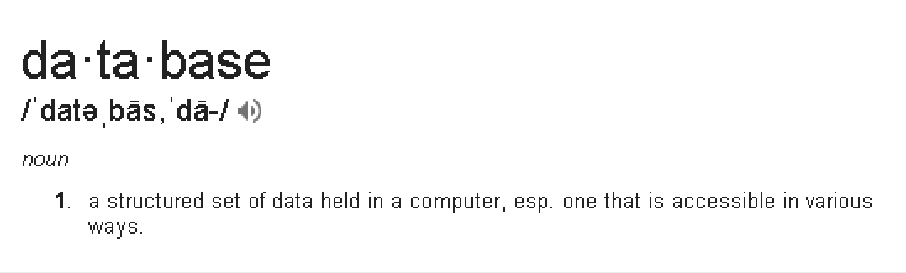
Database Systems
by Google

Slide 6
Databases Systems(2)
A database is a storage where information can be stored
Information meaning computer information like numbers and strings
Two common types of database systems
Relational databases and Non-relational databases

Slide 7
Relational Databases
Relational Database Management Systems or RDBMS
Contain a set of connected tables
Tables have relations between one another
Tables have fixed table schema
The saved data is in strongly-defined format
RDBMS store normalized data
RDBMS have a database language for making CRUD and queries to the database
MySQL, T-SQL, etc…

Slide 8
Non-relational Databases
Non-relational Database Management Systems or NoSQL
Include fast key-value stores and document-oriented databases (DOD)
Contain a set of documents
Documents have no fixed schema
Records in a document can store different data
Store denormalized data

Slide 9
NoSQL Databases

Slide 10
NoSQL Databases
NoSQL databases save data in non-relational way
The data is stored in many documents
Records in a document can be different
Documents can have nested documents
NoSQL databases provide simplicity of design and availability
Used mostly when in need to keep big data or in real-time web apps

Slide 11
MongoDB

Slide 12
MongoDB
MongoDB is an open-source document database
Save JSON-style objects with dynamic schemas
Support for indices
Has document-based queries
CRUD operations

Slide 13
Using MongoDB
Download MongoDB from the official web site:
https://www.mongodb.org/downloads
Installers for all major platforms
When installed, MongoDB needs a driver to be usable with a specific platform
One to use with Node.js, another to use with .NET, etc…
Installing MongoDB driver for Node.js:
$ npm install mongodb -g

Slide 14
Installing MongoDB
Live Demo

Slide 15
Working with MongoDB from Node.js
Once installed, the MongoDB must be started
Go to installation folder and run mongod
$ cd path/to/mondodb/installation/folder
$ mondgod
Or add mongod.exe to the PATH
When run, the MongoDB can be used from Node.js

Slide 16
Creating MongoDB Database
The database is created using Node.js
The 'mongodb' module is required
var mongodb = require('mongodb');
Create a server to host the database
var server = new mongodb.Server('localhost', 27017);
Create mongodb client that connects to the server
var mongoClinet = new mongodb.MongoClient(server);
Open connection to the mongodb server
mongoClient.open(function(err, client){
var db = client.db('DATABASE_NAME');
//queries over the db
});

Slide 17
Creating a MongoDB Database
Live Demo

Slide 18
Queries over MongoDB with Node.js

Slide 19
Queries over MongoDB with Node.js
MongoDB module supports all kinds of queries over the data
Creating new documents
And adding records
Editing existing documents
And their records
Removing documents and records
Querying whole documents or parts of them

Slide 20
Node.js and MongoDB
Live Demo

Slide 21
NoSQL Databases and MongoDB
http://schoolacademy.telerik.com

